Slide 1

Customer Shopping Behavior Analysis

Slide 2

Introduction: Why Analyze Customer Behavior?
E-commerce demands understanding purchasing patterns.
Improve Sales
Boost Engagement
Extract Insights
Enhance strategies.
Connect with customers.
Meaningful business data.

Slide 3
Project Objectives
1
2
Spending Patterns
Revenue & Trends
Analyze across demographics & categories.
Identify high-revenue categories & seasonal trends.
3
4
Impact Analysis
Product Demand
Examine subscription & discount effects.
Understand using ratings, categories, order frequency.
5
6
Real-time Insights
Business Questions
Build Power BI dashboard.
Solve using SQL queries.

Slide 4

Dataset Overview
Customer data for comprehensive analysis.
Demographics: gender, age group
3.9K
$59.76
Purchase Details: amount, previous purchases
Product Details: category, item, review rating
Order Details: shipping, discount, promo code
Total Customers
Avg. Purchase
Customer Type: subscription status
3.8
Avg. Review

Slide 5
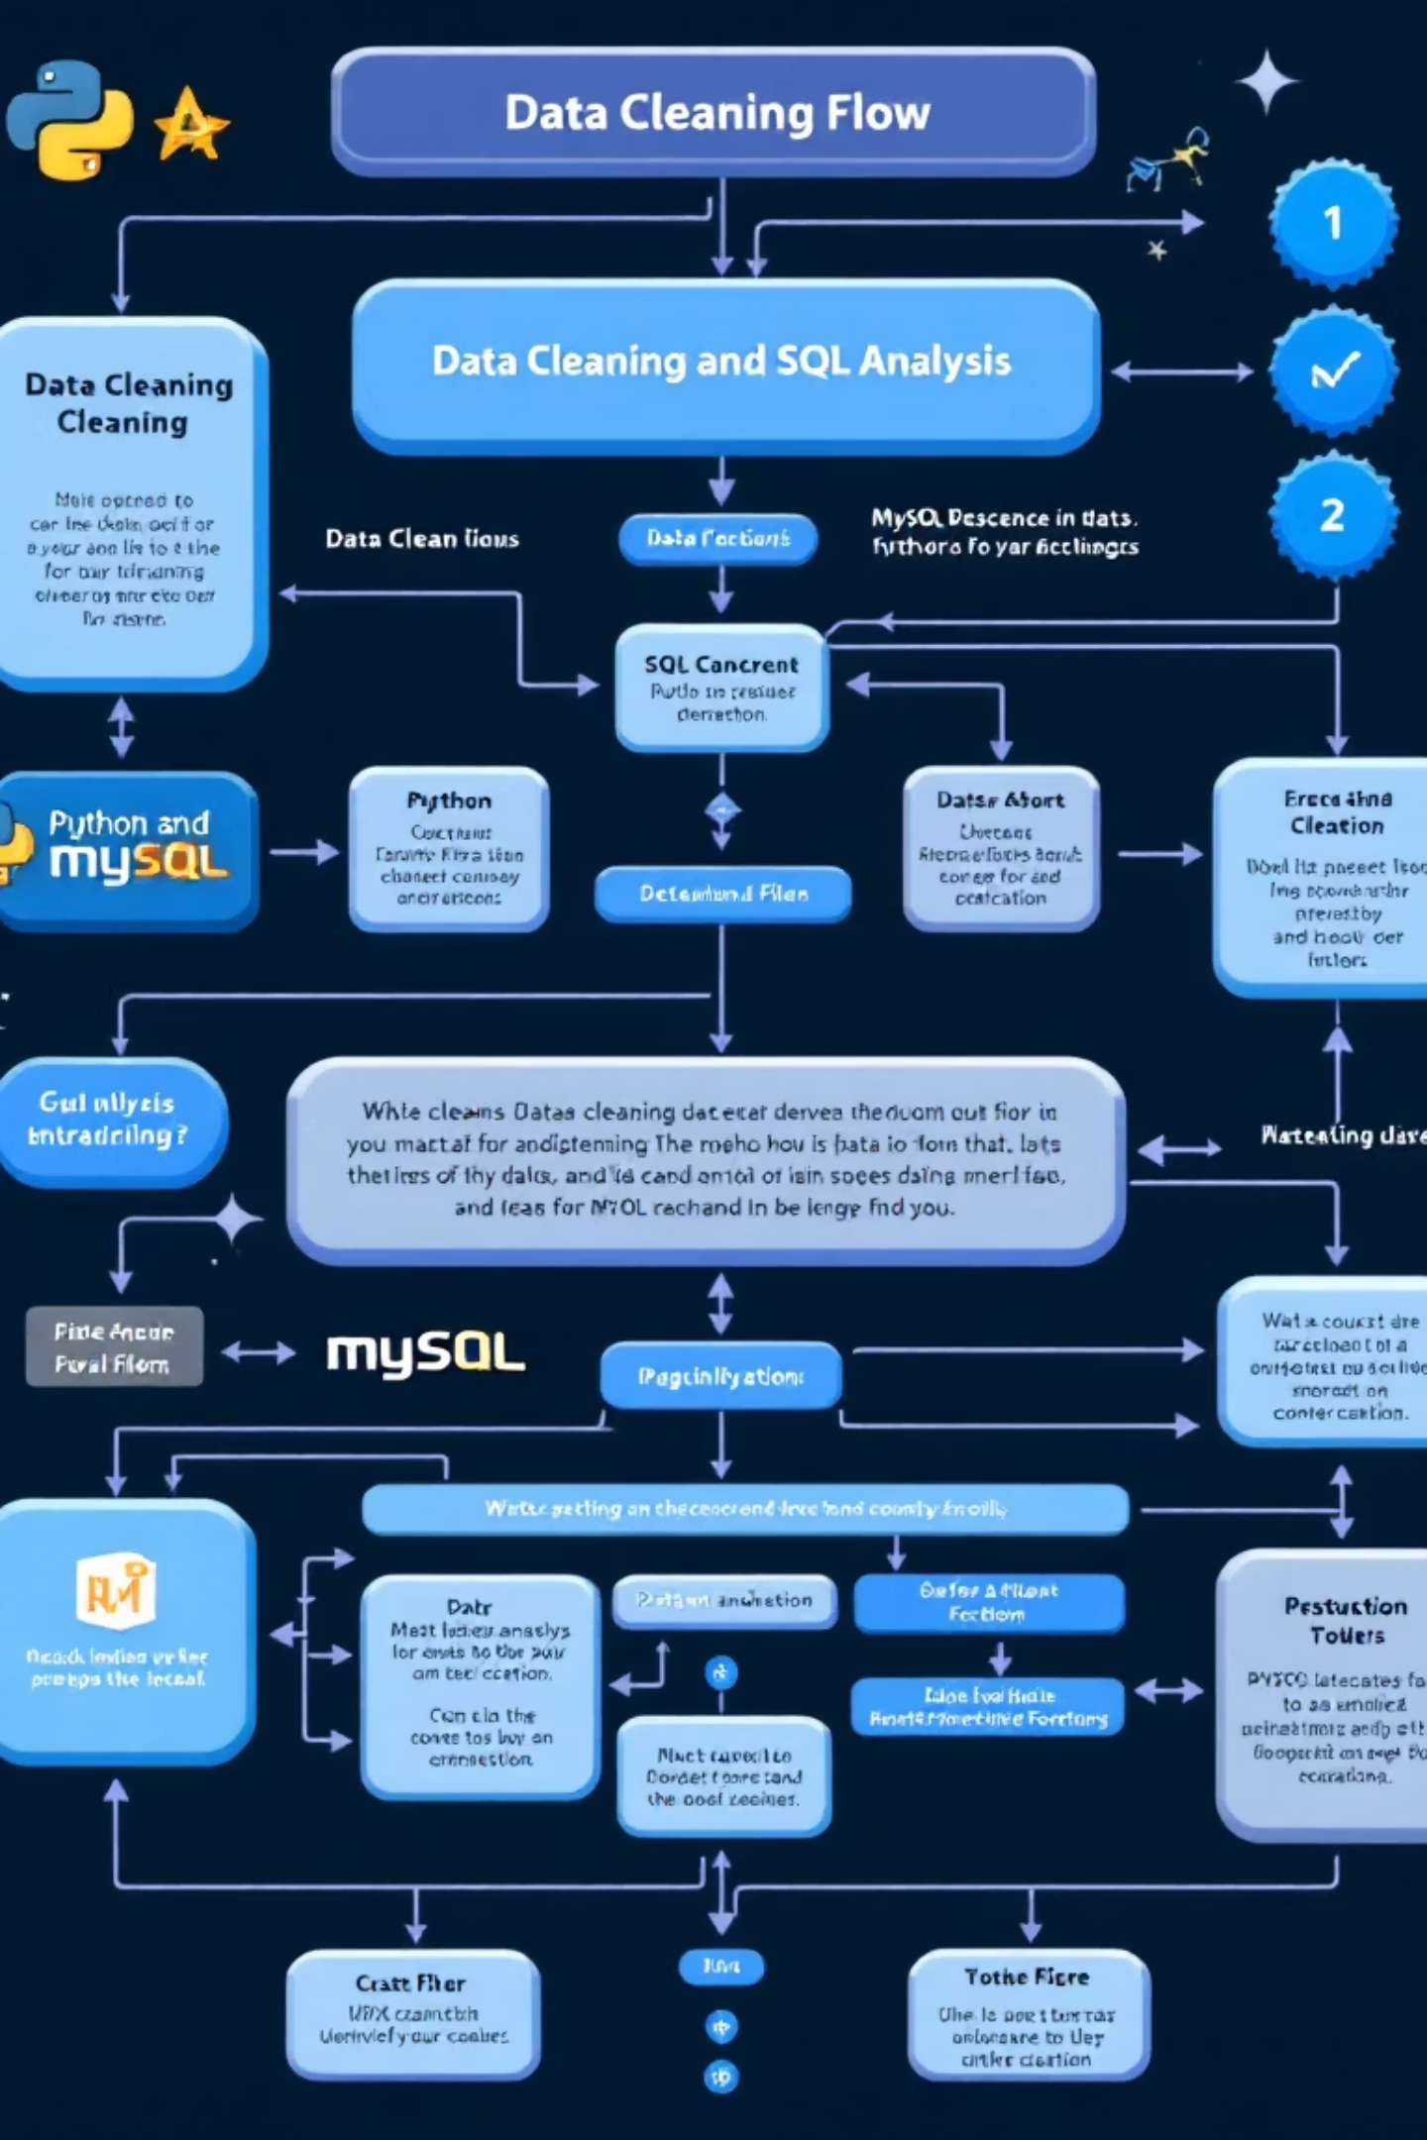


Methodology: Data Cleaning & SQL Analysis
Data Cleaning
Python (Jupyter Notebook): Removed duplicates, cleaned categorical fields, handled missing values, exported to MySQL.
SQL Analysis
MySQL: Solved business questions, identified high-value customers, top products, shipping impact, subscription effects.

Slide 6
Key SQL Insights
1
Revenue by Gender
Identified higher sales generators.
2
High-Value Customers
Discount users with above-average spending.
3
Top 5 Products
By average rating for quality & marketing.
4
Shipping Spending
Compared order value for shipping types.
5
Subscription Impact
Subscribers vs. non-subscribers spending.
6
Discount Usage
Products with highest discount use.
7
Customer Segmentation
New, Returning, Loyal buyers.
8
Revenue by Age Group
Contribution analysis.

Slide 7
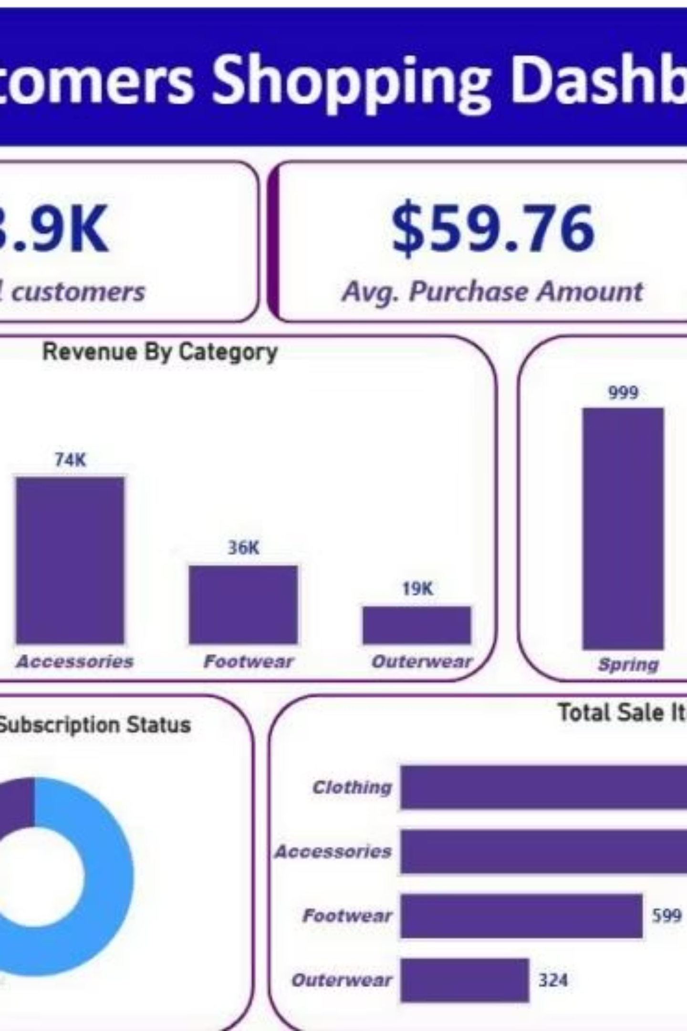
Power BI Dashboard: Visualizing Insights
Interactive dashboard for real-time data exploration.

Slide 8

Dashboard Highlights
Key Performance Indicators
Season-Wise Sales
Total Customers: 3.9K
Spring: 999 (Highest orders)
Avg. Purchase: $59.76
Fall: 975
Avg. Review: 3.8
Customer Subscription
Revenue by Category
No: 73%
Clothing: 104K (Highest)
Yes: 27%
Accessories: 74K
Scope to promote subscriptions.

Slide 9
Key Findings
Clothing Dominates
Moderate Spending
Top revenue & units sold.
Avg. purchase $59.76.
Spring Peak
Subscription Potential
Highest demand season.
73% non-subscribers.
Subscribers Spend More
Discount Influence
Confirmed by SQL.
Boosts sales, impacts profit.
Shipping Affects Spending
Age Group Contributions
Express users spend more.
Middle-aged groups maximize revenue.

Slide 10

Conclusion & Tools
Successful end-to-end data analysis.
Key Achievements
Tools & Technologies
Cleaned & structured data (Python)
Python (Pandas, NumPy, Matplotlib)
Strong SQL analytics
MySQL
Interactive Power BI dashboard
Power BI Desktop
Jupyter Notebook
Meaningful business findings

